Slide 1
Crash Course to Electronics
Install:
Arduino Software
USB Drivers

Slide 2

About me
EE Year 3
NUS Hackers
CAPT
Loves technology
& philosophy

Slide 3
Bits and Bytes
5
0101
1010
10
5
a
ASCII
Hexadecimal
Decimal
Binary
Z
8 bits = 1 byte

Slide 4
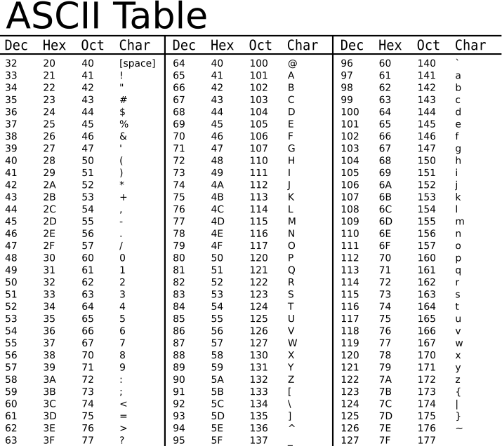
ASCII
41 30 31 32 34 31 38 35 4A
A0124185J
31 (Oct)
25 (Dec)

Slide 5
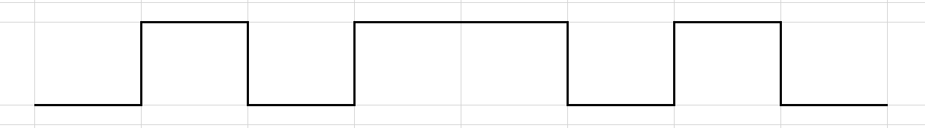
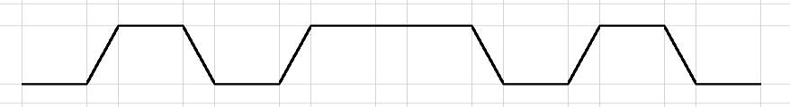
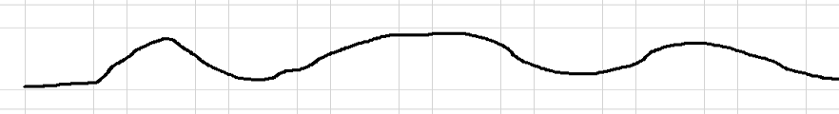
Highs and Lows
0 1 0 1 1 0 1 0

Slide 6
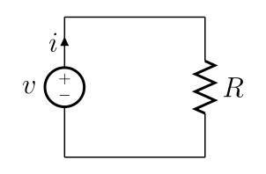
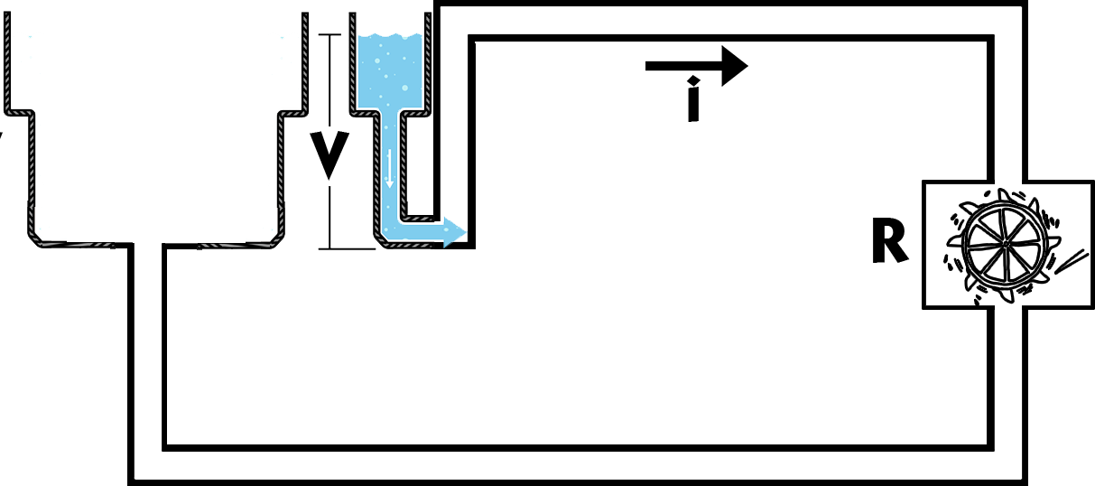
What is voltage?
V=iR

Slide 7
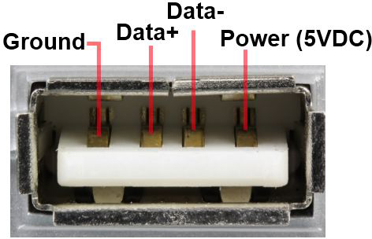
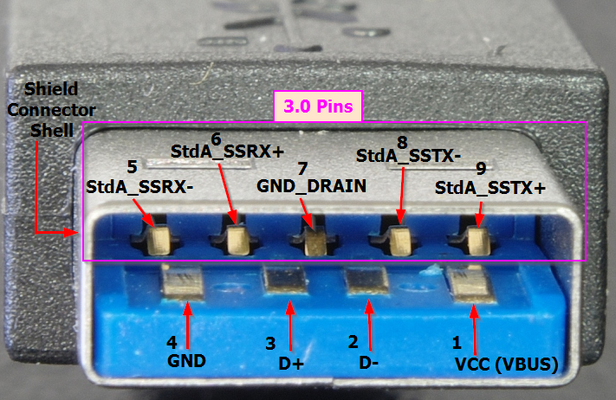
USB
USB2.0
480Mbps ~ 480 million bits
60MBps
USB3.0
5Gbps ~ 5 billion bits
640MBps

Slide 8
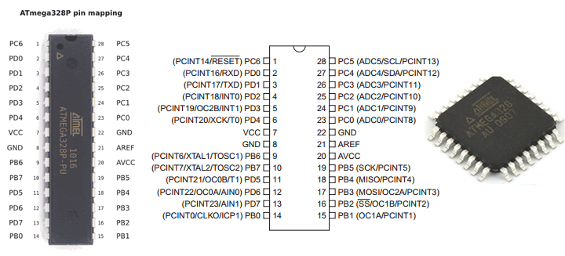
Microcontrollers
Brain of hardware
Have multiple lines, or connections

Slide 9
Questions?

Slide 10
Hands on!
Materials: Breadboard Arduino Mini-USB Cable Button LED bulb 220 Ohm Resistor Jumper Wires (x5)

Slide 11
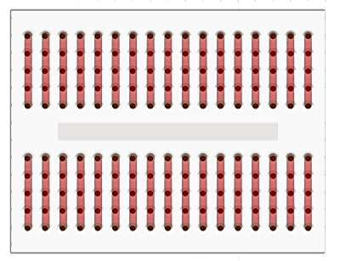
Breadboard

Slide 12
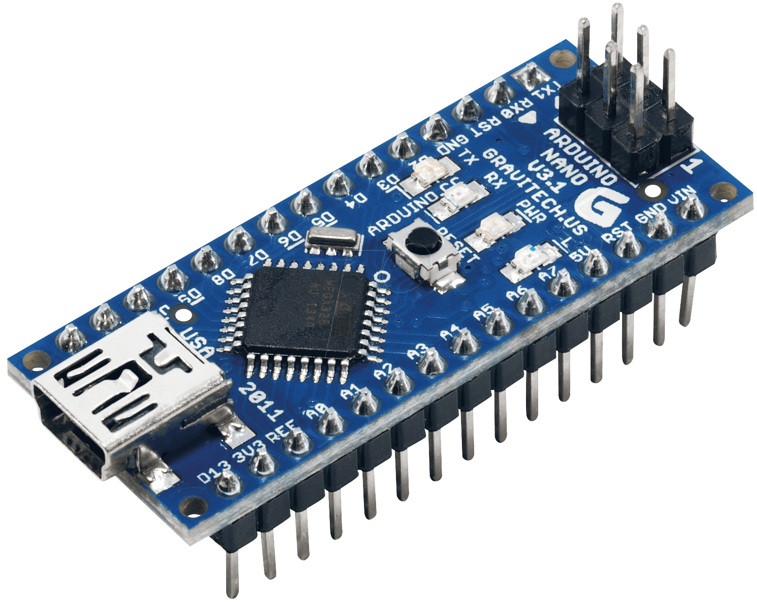
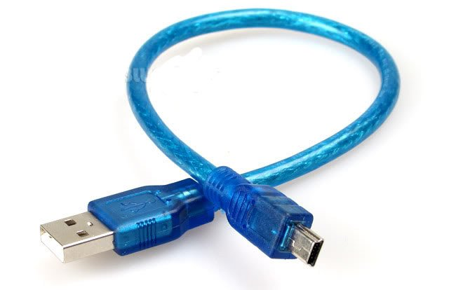
Arduino

Slide 13
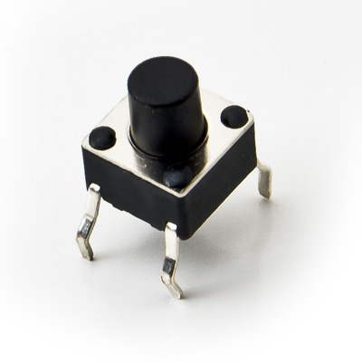
Button

Slide 14
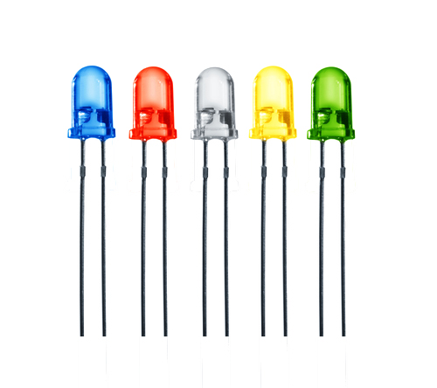
LED

Slide 15
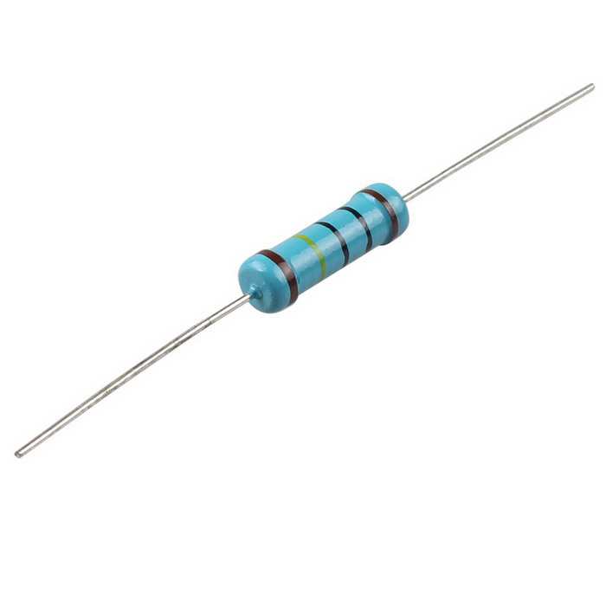
Resistor

Slide 16
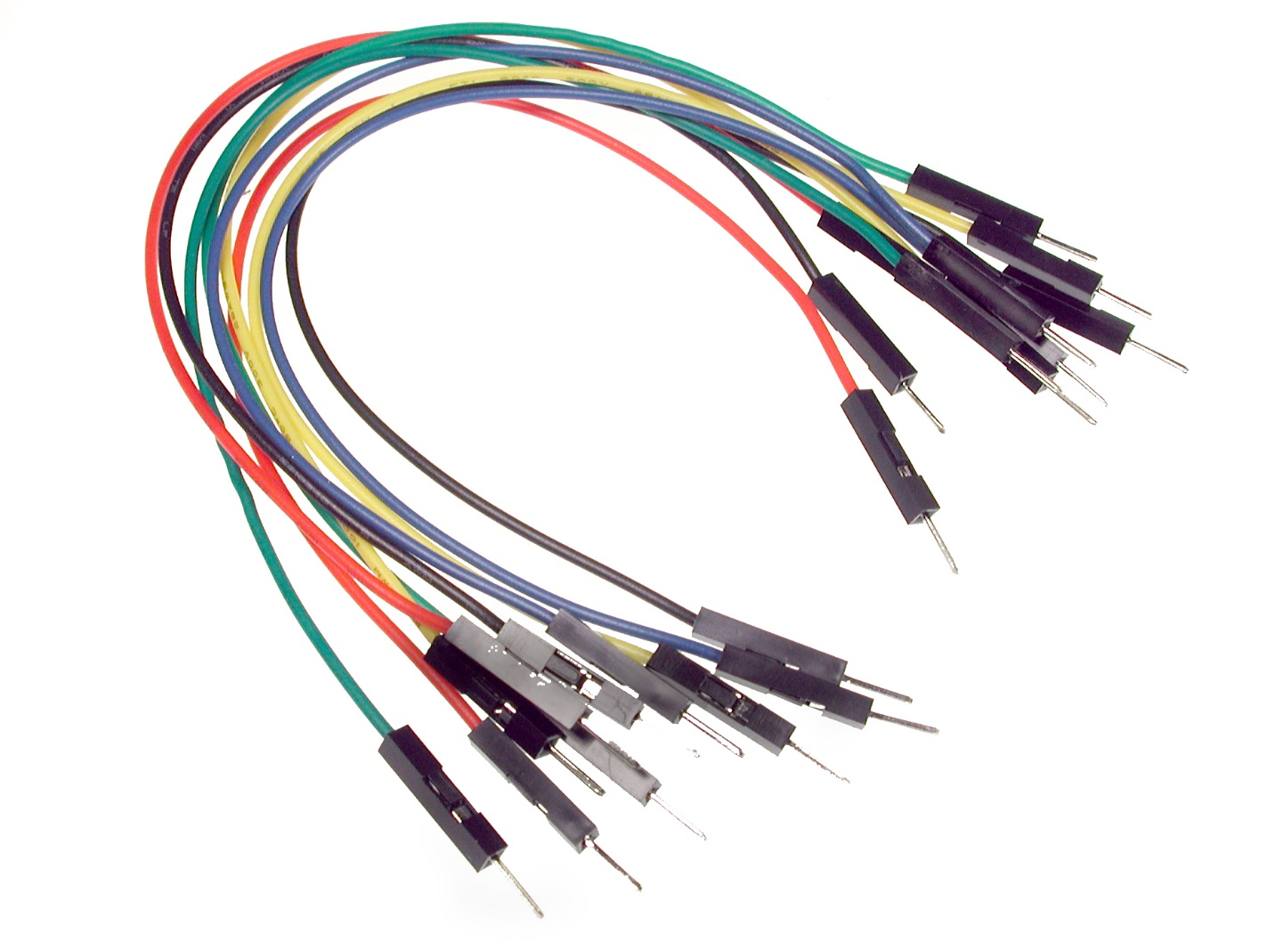
Jumper wires x5

Slide 17
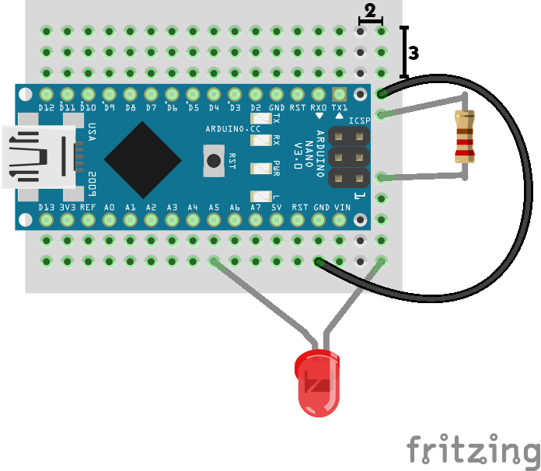
Lighting an LED
GND
A5

Slide 18
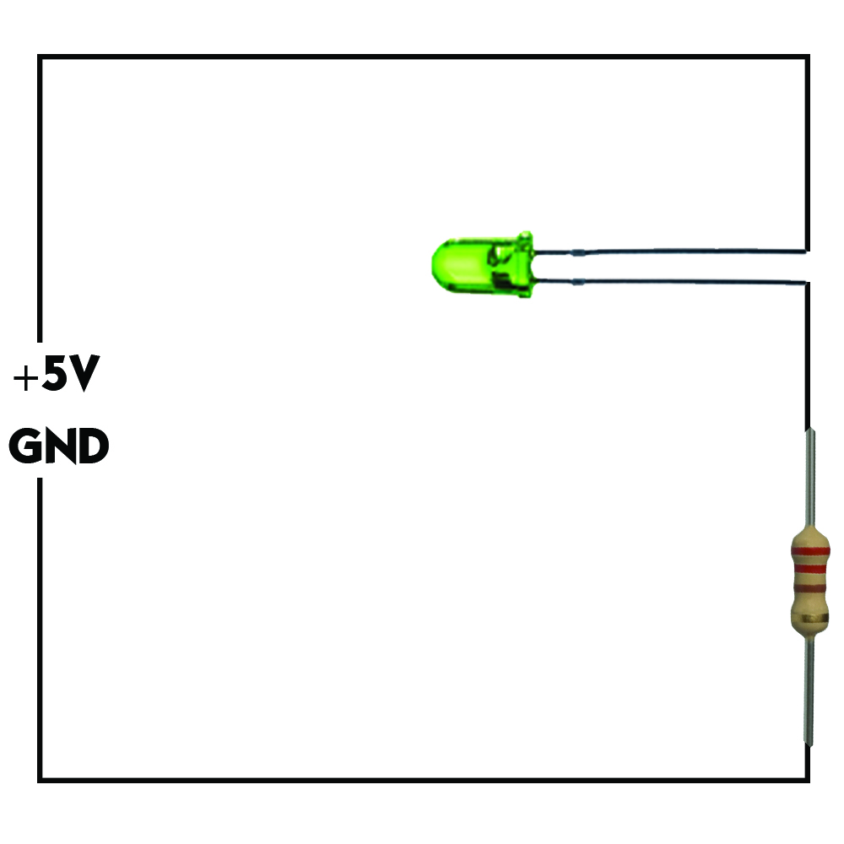
Equivalent circuit

Slide 19
Why resistor?
Arduino current < 50mA LED current < 30mA
Source voltage = 5V LED voltage drop = 2V Resistance = 220 ohm
V = IR
Current = (5V-2V)/220 ohm = 14mA

Slide 20
Code
int ledPin = A5;
Set ledPin as A5 for future usage
void setup() {
pinMode(ledPin, OUTPUT);
}
Initialize ledPin (pin A5) as OUTPUT pin
void loop() {
digitalWrite(ledPin, HIGH);
delay(1000); digitalWrite(ledPin, LOW); delay(1000);
}
Turn LED on by setting voltage to high, sleep for 1s, then turn LED off by setting voltage to low

Slide 21
Uploading
Tools → Board → Arduino Nano
Tools → Port →
wchusbserialxxx (Mac)
COMx (PC)
Upload!

Slide 22
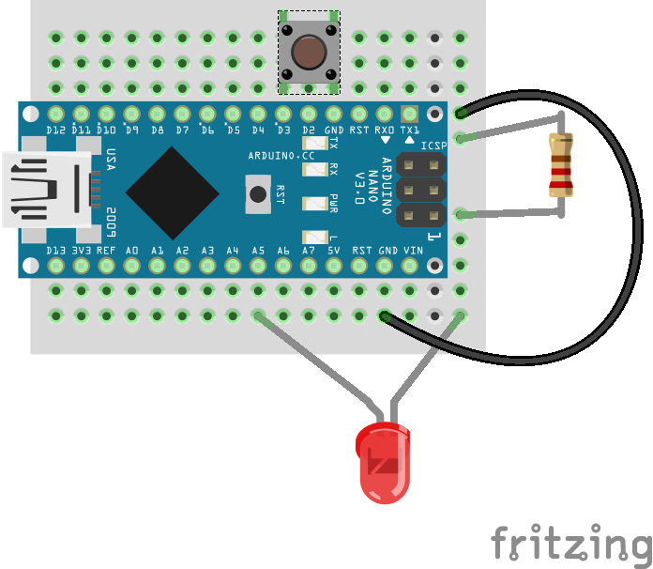
D3
GND
Using a button

Slide 23
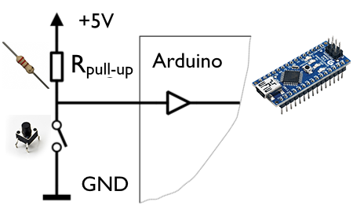
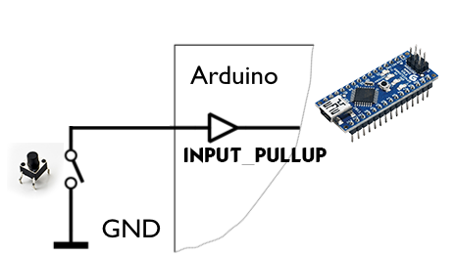
Equivalent circuit

Slide 24
Code
int ledPin = A5;
int buttonPin = 3;
Set button as D3 for future usage
void setup() {
pinMode(ledPin, OUTPUT);
pinMode(buttonPin, INPUT_PULLUP);
}
Initialize buttonPin (D3) as INPUT_PULLUP
void loop() {
if (digitalRead(buttonPin) == LOW) {
digitalWrite(ledPin, HIGH);
} else {
digitalWrite(ledPin, LOW);
}
}
If button is pressed (buttonPin reads low), turn LED on
Else turn LED off

Slide 25

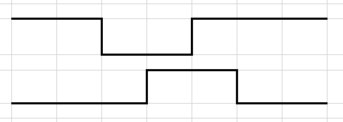
Timing diagram
Button Pin
LED Pin
Button Pin
LED Pin

Slide 26
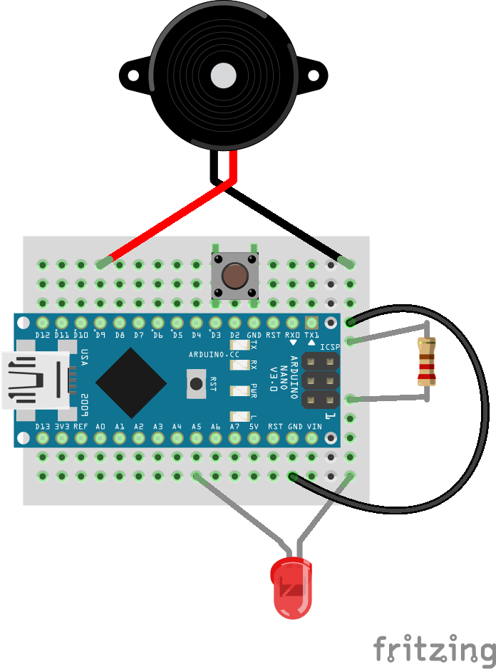
D9
Playing a tone

Slide 27
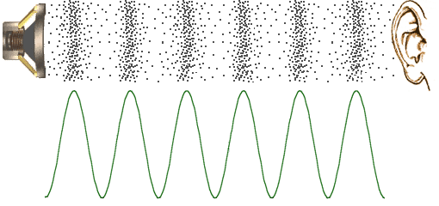
Soundwaves
Human hearing frequency = 20Hz - 20KHz

Slide 28
Code
int ledPin = A5;
int buttonPin = 3;
int buzzerPin = 9;
Set buzzerPin as A0 for future usage
void setup() {
pinMode(ledPin, OUTPUT);
pinMode(buttonPin, INPUT_PULLUP);
}
No need to set up buzzerPin
void loop() {
if (digitalRead(buttonPin) == LOW) {
digitalWrite(ledPin, HIGH);
tone(buzzerPin, NOTE_C6, 1000);
} else {
digitalWrite(ledPin, LOW);
}
}
If button is pressed (buttonPin reads low), play the tone NOTE_C6 on buzzerPin for 1s

Slide 29
Importing library

Slide 30
Playing music!
void loop() {
if (digitalRead(buttonPin) == LOW) {
digitalWrite(ledPin, HIGH);
play(buzzerPin);
digitalWrite(ledPin, LOW);
}
}
If button is pressed, turn on LED, play music, then turn off LED
void play(int buzzerPin) {
int notes[] = {NOTE_A3, NOTE_A3, NOTE_A3, NOTE_F3, NOTE_C4, NOTE_A3, NOTE_F3,
NOTE_C4, NOTE_A3};
int noteDurations[] = {4, 4, 4, 8, 12, 4, 8, 12, 2};
for (int thisNote = 0; thisNote <(sizeof(noteDurations)/sizeof(int)) ; thisNote++) {
int noteDuration = 2000 / noteDurations[thisNote];
tone(buzzerPin, notes[thisNote], noteDuration);
int pauseBetweenNotes = noteDuration + 1;
delay(pauseBetweenNotes);
}
}

Slide 31
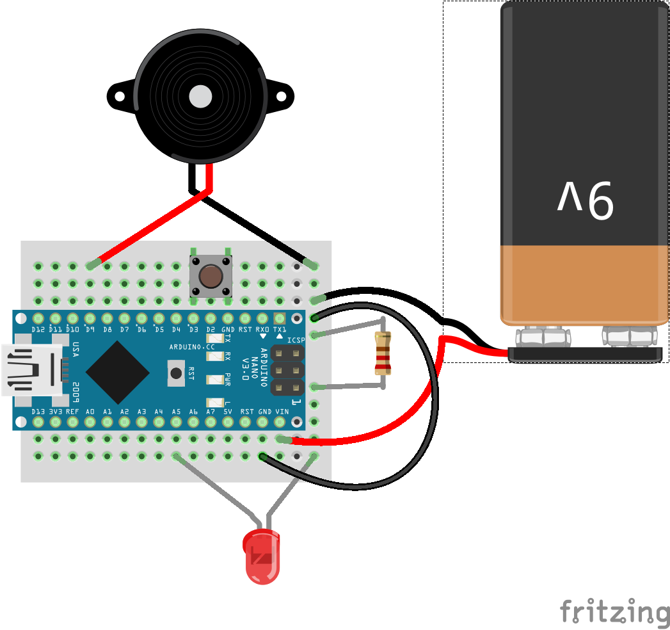
Powering the Arduino
VIN

Slide 32
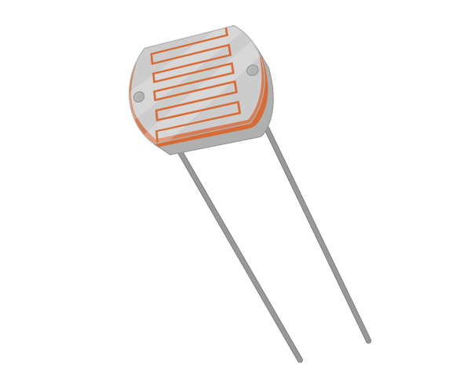
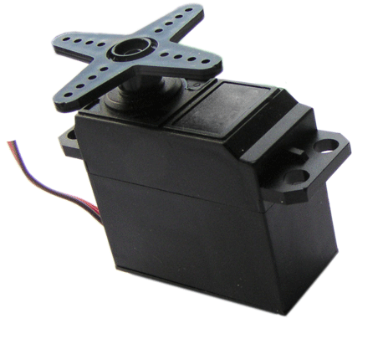
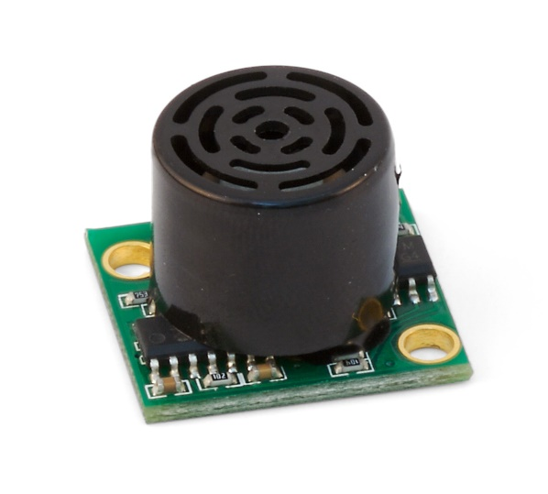
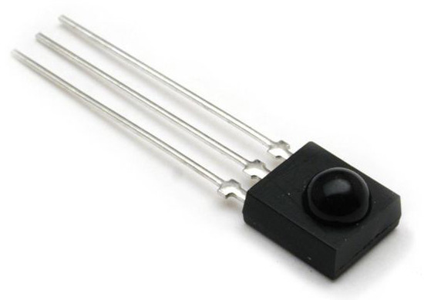
Common components
Light Dependent Resistor
Servo Motor
Sonar Sensor
Infrared Sensor

Slide 33
The End
Feedback
goo.gl/xeNWnj

